Slide 1

DDPG algorithm
PyTorch Implementation with addition of SWA

Slide 2
Part 1 – Reinforcement Learning
We’re given Agent in some Environment ( e.g. Agent playing shooter game). The environment consists of :
1)States - all the possible positions Agent can be in (e.g. for shooter game – all the positions on the map multiplied by all the possible angles our agent can look at )
2)Actions – all the possible actions Agent can take in a given state(e.g. for shooter game – move in any direction/rotate camera/shoot etc.)
3)Rewards – award given to agent for following some action (e.g. for shooter game – obvious one would be killing an enemy , not dying is a reward as well – we could for example assign negative values for all actions leading to death or very small reward for all actions leading to staying alive)
*Policy is a function that maps every state to the action
The aim of the RL algorithm is to optimize action decision process(find optimal policy) , i.e. given a state of the agent , choose action that’ll lead to maximization of overall reward ( which is calculated at the end of the task/time) .

Slide 3
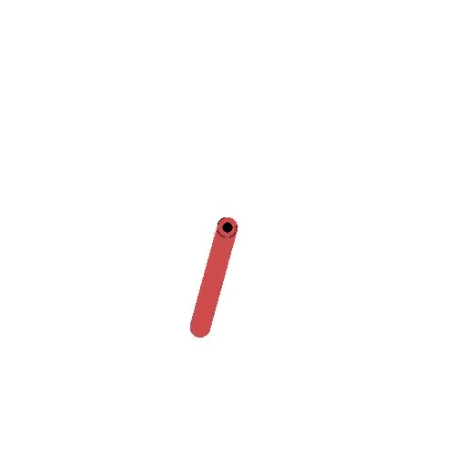
Example of RL Environment – Pendulum Swing
Aim – put pendulum in the straight upward position
State –possible position of the pendulum (if we were to be accurate to degree there’d be 360 of them)
Action – Swing right/left with force from (0,1] / do nothing
Reward – for every timestep pendulum isn’t in “aim position” add -1 to final reward
https://gym.openai.com/envs/Pendulum-v0/

Slide 4
Part 2 . How to solve RL problem ?
There are quite a lot of ways to solve RL problems . Firstly we need to know more about the environment :
-Are states discrete or continuous ? -Are actions discrete or continuous ? -Are we given the model of environment( e.g. transition probability distribution ) -Is environment stochastic or deterministic ? (i.e. does attempt of taking action b always results in taking act b?) -Can we come up with some greedy policy without need for complex calculations? (e.g. for shooting game - always shoot →hide → reload might be a good greedy approach )
And even after getting answer to all these questions, we might still be left with plenty of algorithms for each scenario
In our case we’re dealing with :
-Continuous Actions & States
-We are not given model of environment , therefore there is need to learn from experience
-The environment is deterministic(although algorithm we introduce can as well work for stochastic env)
-There might exist greedy algorithms(policies) that work quite well , but we want to find even better policy, that’d give us hopefully even better results
Solution : DDPG !

Slide 5
DDPG
DDPG , short for Deep Deterministic Policy Gradient is a reinforcement learning algorithm, that can be used for the case of deterministic continuous state and action space environment when we are not given model of environment .
DDPG is off-policy algorithm , i.e. it learns the value of the optimal policy independently of the agent's actions
The prefix ‘deep’ comes from the fact we are using neural networks , ‘deterministic’ since it’s used in that type of environment , and ‘policy gradient’ since it uses gradient in calculus to optimize our policy.
Before we jump into DDPG itself let’s understand two important parts of it :
1)Policy Gradient which is used in Actor & Critic
2)Actor & Critic structure which is important part of DDPG algorithm

Slide 6
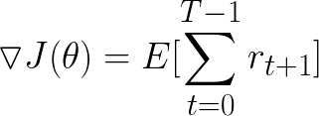
Deterministic Policy Gradient
The objective of a Reinforcement Learning agent is to maximize the overall reward
Therefore optimal policy is the one that will give use optimal reward
Let’s find policy that maximizes reward function J (which is parameterized by θ) :
*Since we’re talking about functions , the best possible way to approximate and parameterize function is artificial neural network

Slide 7

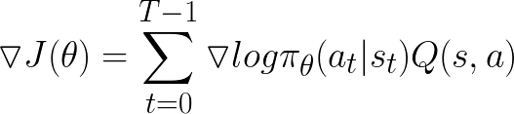
Finding optimum policy using Gradient Ascent
Since this is a maximization problem, we can find the optimal policy(which is parameterized on theta) by using gradient ascent method :
What’s left now is finding the gradient of J(θ) , which after some calculations can be expressed in the form :
*Where Q is the sum of discounted future rewards
We use Q value, to make sure we optimize faster and converge on the results that seem “good” rather than “bad”. We do it by assigning weight to each action(this way we amplify gradient ) , giving “good” actions bigger values and “bad” actions lower values (a good value to use Is therefore , it gives “good” action bigger weight while giving “bad” functions smaller weights)
*Since we want to use Neural Network we create a very similar loss function : L= −Q̂ (s,a)logπθ(a|s) that our neural network is minimizing

Slide 8
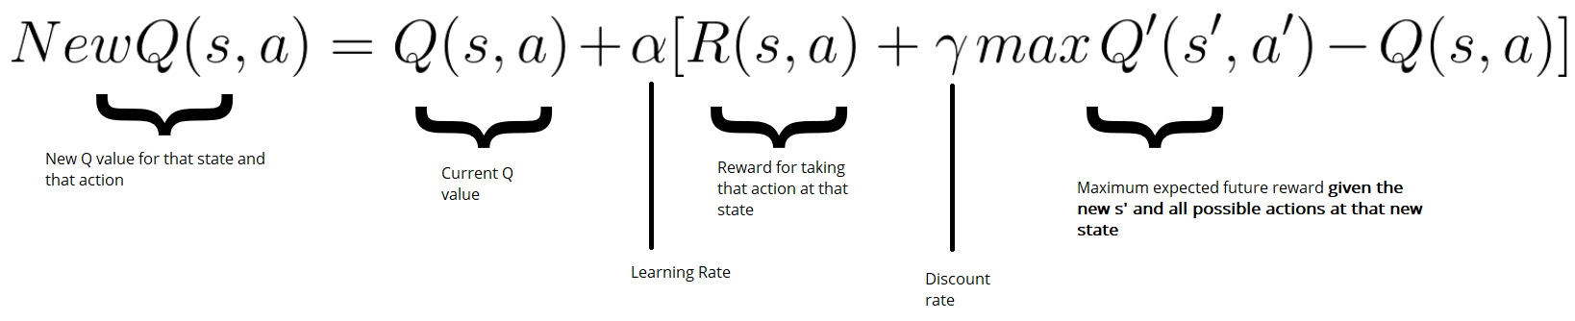
Problem with Q-value
Bellman’s Equation :
If we knew every Q-value then the problem would be solved from the very beginning , we would know which action gives the best results(biggest overall reward)
Therefore Q-value is something that gets updated over time.
The update rule follows Bellman’s Equation

Slide 9

Actor & Critic Method
At this point we’ve got one neural network that uses Loss Function : L=−Q̂ (s,a)logπθ(a|s) to maximize the reward , and the bellman equation to update Q-values .
Let’s name the one neural network we have so far Actor - it plays the main role in our little spectacle after all.
Let’s introduce the 2nd neural network(Critic) which aim will be to approximate Q function
The update rule it should follow would look like this :
And the loss function would follow by looking something like this : F = ( new Q – old Q)² [summed over batch]
So far we’ve cursorily introduced the ideas , now let’s put them all together !

Slide 10

DDPG
The idea behind DDPG consists of couple parts :
1) Use of two Actors and two Critics which greatly improve stability in learning . One pair which is continuously updated using loss functions , and the other pair called target pair , that gets slowly updated using previous pair’s weights.
2)Use of Replay Buffer that stores previously acquired experience in tuples of form : Since DDPG is model-free algorithm(we’re not given transition distributions , therefore we need to learn from our experience, storing more experience means ability to learn from it multiple times )
3) Use of random noise . We need to make sure that our algorithm will keep on exploring all possible paths instead of endlessly exploiting one path that might not be optimal. For continuous action space case we add a little noise that make the algorithm choose a bit different path each time resulting in wider exploration .
4) Update of neural networks is done using sample batches – at every iteration update a random batch is sampled from Replay Buffer which is later used to minimalize Loss Function
5) Weights are initialized randomly

Slide 11
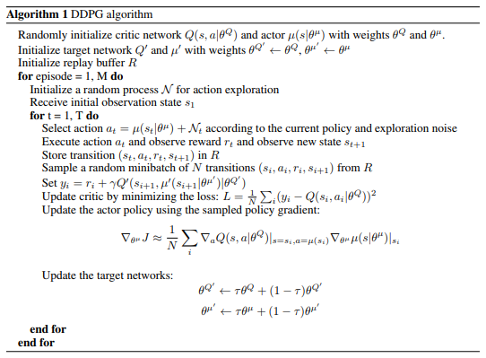
DDPG algorithm
Pay Attention to :
1)The fact that actions are calculated using non-target actor
2)Critic loss function uses difference between Q values calculated by target Critic and non-target one
3)Actor gradient is calculated using non-target functions
From all above we can conclude that outside of Q value comparison , the training doesn’t include target networks .

Slide 12
DDPG optimization and use cases
Use cases of DDPG include environments such as :
Cheetah – agent learning
Further optimizations used for getting better and faster results in DDPG include :
Either randomly or uniformly initializing weights in Neural Networks , which results again , in a better and faster convergence
Using Batch Normalization , so that all the layers outputs as well as the actions have the mean 1 and variance 0 , resulting in reduced overfitting which otherwise would be a major problem . Again , such an idea causes faster convergence and better stability of our algorithm

Slide 13
Improving DDPG using SWA
SWA stands for Stochastic Weight Average , and is a simple procedure that improves generalization in deep learning over Stochastic Gradient Descent optimizer.
As the name suggests SWA takes average of SGD’s weight , but devil is in the details.
While training SWA uses a modified learning rate schedule , so that SGD continues to explore the set of high-performing networks instead of simply converging to a single solution. We divide process into two parts : →1st “Proper” training where we use decaying learning weight to converge closer to solution ( but not too close) →2nd where we set the learning rate to reasonably high constant , this way algorithm keeps on exploring , and we take average of 2nd part’s weights
For example, we can use the standard decaying learning rate strategy for the first 75% of training time, and then set the learning rate to a reasonably high constant value for the remaining 25% of the time
SWA works in the background , it doesn’t influence training process , instead it takes average of weights of the last training bit , and then swaps the weights at the end of the training.

